Slide 1
Merge sort (divide and conquer)
Name : Mohamed Fayed Aburawash
ID : 224411

Slide 2
What is sorting
Sorting is to rearrange items systematically in specific order.

Slide 3



Slide 4
Divide and conquer
divide the problem into two halves, solve each half separately, and then connect them in the end

Slide 6
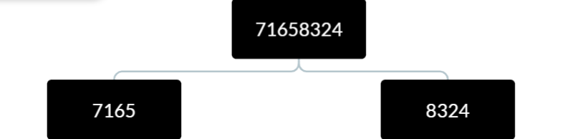

Slide 7
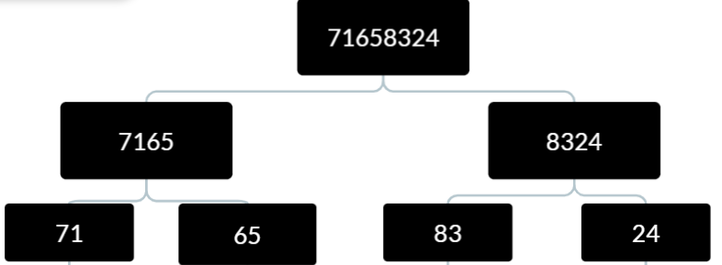

Slide 8
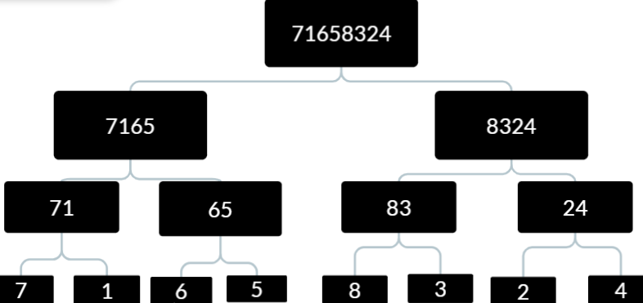

Slide 9
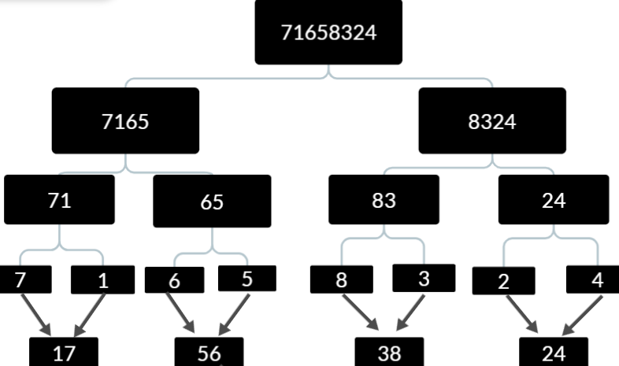

Slide 10
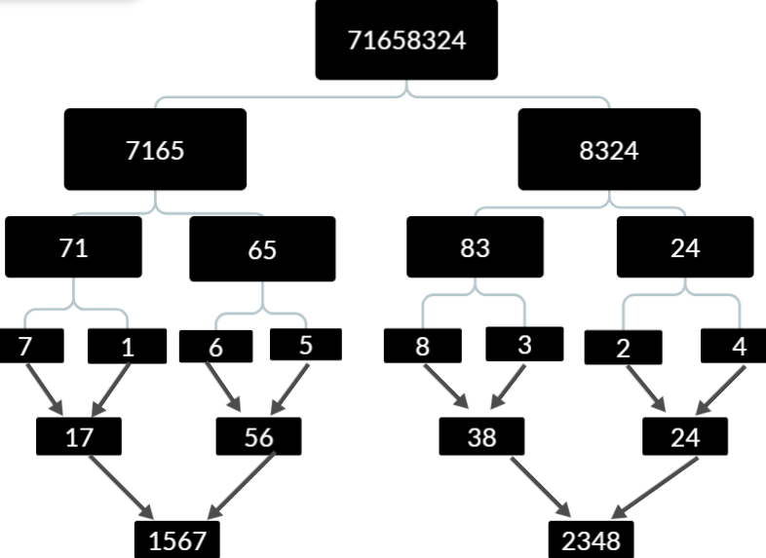

Slide 11
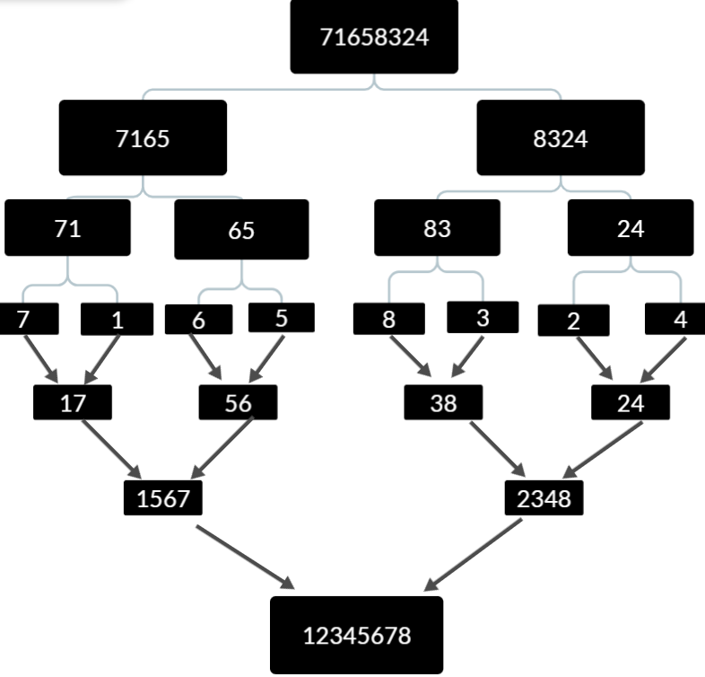

Slide 12

Time Complexity Analysis
$T\left(n\right)=\log_{2}\left(num\right) . \frac{num}{k}.O(n)$
So finally it will be $T\left(n\right)=O(n\log{n)}$
$\log_{2}{(num) }$for the outer loop
The total work of the middle loop is $O(n)$

Slide 13

space Complexity Analysis
Temporary array b is used with size $O(n)$
The other variables (left , right , last , m ,I , J)
In each iteration of the middle loop, a temporary array of size $n$ is used for merging.
Therefore, the space complexity due to the temporary array is $O(n)$

